Slide 1

CS 584 Machine Learning
Week 11
March 27, 2019

Slide 2

Week 11 Agenda
Directed Acyclic Graph
Bayesian Network
Naïve Bayes
Chapter 14 of the Machine Learning book

Slide 3
Directed Acyclic Graph
A Directed Acyclic Graph (DAG) visually displays assumptions about the relationship between variables
The variables are called nodes in the context of graphs
The relationships are represented by lines (or edges) going from one node to another.
These edges are directed indicating the assumed causal relationships between the nodes
These edges are acyclic indicating the assumed causal relationships are one-directional, or there are no feedback relationships

Slide 4
Directed Acyclic Graph
Origin affects DriveTrain and Cylinders
DriveTrain and Cylinders each individually affects Type
There is no relationship between Cylinders and DriveTrain
Cylinders
Origin
Type
DriveTrain

Slide 5
Bayesian Network
A Bayesian network is a directed acyclic graphical model that represents probability relationships and conditional independence structure between random variables
A Bayesian network is a family of algorithms that are primarily for classification
Naïve Bayes
Tree-augmented Naïve Bayes (TAN)
Parent-child Bayesian Network
Markov Blanket

Slide 6
Bayesian Network Example
Russell and Norvig (2010). Artificial Intelligence: A Modern Approach, Third Edition. New Jersey: Pearson.
You live in an area (e.g., San Francisco Bay) where earthquakes are not uncommon
Your house has an alarm system against burglary, and the alarm system can be set off occasionally by an earthquake.
You have two neighbors, Mary and John, who do not know each other. If they hear the alarm, they might or might not call you.

Slide 7
Bayesian Network Example
The events are (1) Burglary, (2) Earthquake, (3) Alarm Sounds, (4) John calls you, and (5) Mary calls you.
The relationships are visualized in the Direct Acyclic Graph below

Slide 8
Bayesian Network Example
The probabilities are either assigned or observed.
Earthquake and Burglary are assumed independent
Mary and John independently decide whether to call you
Whether Mary or John calls is conditionally dependent only on the state of the alarm.
The purpose of their calls is to inform you that your alarm has sounded, and not to tell you the cause.
You are responsible to find out the cause.

Slide 9
Bayesian Network Example
The joint probability distribution of the events (B, E, A, J, and M) is Pr(B, E, A, J, M)
By the Bayes’ theorem, Pr(B, E, A, J, M) = Pr(J, M|B, E, A) * Pr(B, E, A)
Since Mary and John are assumed independent, Pr(J, M|B, E, A) = Pr(J|B, E, A) * Pr(M|B, E, A)
Bayesian Network assumes that Pr(J|B, E, A) = Pr(J|A) and Pr(M|B, E, A) = Pr(M|A). In other words, the events B and E do not help either John or Mary decide whether to call you if they already knew the state of the alarm.

Slide 10
Bayesian Network Example
Similarly, Pr(B, E, A) = Pr(A|B, E) * Pr(B, E) from Bayes’ Theorem
The events Burglary and Earthquake are assumed independent, thus Pr(B, E) = Pr(B) * Pr(E).
Therefore, Pr(B, E, A, J, M) = Pr(J, M|B, E, A) * Pr(B, E, A) = Pr(J|B, E, A) * Pr(M|B, E, A) * Pr(B, E, A) = Pr(J|A) * Pr(M|A) * Pr(A|B, E) * Pr(B) * Pr(E).
The network structure together with the conditional probability distributions completely determines the Bayesian network model.

Slide 11
Bayesian Network Example: Scenario 1
Suppose you are at work, the house is being burglarized (B = True), there is no earthquake (E = False), neither John nor Mary calls to say your alarm is ringing (J = False and M = False). What is the probability that the alarm went off (A = True)?
Need this probability Pr(A = T|B = T, E = F, J = F, M = F) = Pr(A|B,~E, ~J, ~M) = Pr(B, ~E, A, ~J, ~M) / Pr(B, ~E, ~J, ~M)

Slide 12
Bayesian Network Example: Scenario 1
Pr(B, ~E, A, ~J, ~M) = Pr(~J|A) * Pr(~M|A) * Pr(A|B, ~E) * Pr(B) * Pr(~E) = (1 – 0.9) * (1 - 0.7) * (0.94) * (0.01) * (1 – 0.02) = 0.000276360
Pr(B, ~E, ~A, ~J, ~M) = Pr(~J|~A) * Pr(~M|~A) * Pr(~A|B, ~E) * Pr(B) * Pr(~E) = (1 – 0.05) * (1 - 0.01) * (1 – 0.94) * (0.01) * (1 – 0.02) = 0.000553014
Pr(B, ~E, ~J, ~M) = Pr(B, ~E, A, ~J, ~M) + Pr(B, ~E, ~A, ~J, ~M) = 0.000276360 + 0.000553014 = 0.000829374

Slide 13
Bayesian Network Example: Scenario 1
Suppose you are at work, the house is being burglarized (B = True), there is no earthquake (E = False), neither John nor Mary calls to say your alarm is ringing (J = False and M = False). What is the probability that the alarm went off (A = True)?
Need this probability Pr(A = T|B = T, E = F, J = F, M = F) = Pr(A|B,~E, ~J, ~M) = Pr(B, ~E, A, ~J, ~M) / Pr(B, ~E, ~J, ~M) = 0.000276360 / 0.000829374 = 0.333215172
In summary, the conditional probability of the alarm having gone off in this situation is about 0.33.

Slide 14
Bayesian Network Example: Scenario 2
Suppose you are at work, the house is burglarized (B = True), there is no earthquake (E = False), your neighbor Mary calls to say your alarm is ringing (M = True), but neighbor John doesn’t call (J = False). What is the probability that the alarm went off (A = True)?
The probability is Pr(A = T|B = T, E = F, J = F, M = T) = Pr(A|B,~E, ~J, M) = Pr(B, ~E, A, ~J, M) / Pr(B, ~E, J, ~M)

Slide 15
Bayesian Network Example: Scenario 2
Pr(B, ~E, A, ~J, M) = Pr(~J|A) * Pr(M|A) * Pr(A|B, ~E) * Pr(B) * Pr(~E) = (1 – 0.9) * (0.7) * (0.94) * (0.01) * (1 – 0.02) = 0.000644840
Pr(B, ~E, ~A, ~J, M) = Pr(~J|~A) * Pr(M|~A) * Pr(~A|B, ~E) * Pr(B) * Pr(~E) = (1 – 0.05) * 0.01 * (1 – 0.94) * (0.01) * (1 – 0.02) = 0.000005586
Pr(B, ~E, ~J, M) = Pr(B, ~E, A, ~J, M) + Pr(B, ~E, ~A, ~J, M) = 0.00064484 + 0.000005586 = 0.000650426

Slide 16
Bayesian Network Example: Scenario 2
Suppose you are at work, the house is burglarized (B = True), there is no earthquake (E = False), your neighbor Mary calls to say your alarm is ringing (M = True), but neighbor John doesn’t call (J = False). What is the probability that the alarm went off (A = True)?
The probability is Pr(A = T|B = T, E = F, J = F, M = T) = Pr(A|B,~E, ~J, M) = Pr(B, ~E, A, ~J, M) / Pr(B, ~E, ~J, M) = 0.000644840 / 0.000650426 = 0.991411782
In summary, the conditional probability of the alarm having gone off in this situation is about 0.99.

Slide 17
Bayesian Network Example: Pr(A = True)
What is the overall probability that the alarm went off (A = True)?
The probability is Pr(A) = Pr(A|B,E)*Pr(B,E) + Pr(A|~B,E)*Pr(~B,E) + Pr(A|B,~E)*Pr(B,~E) + Pr(A|~B,~E)*Pr(~B,~E) = Pr(A|B,E)*Pr(B) *Pr(E) + Pr(A|~B,E)*Pr(~B)*Pr(E) + Pr(A|B,~E)*Pr(B) *Pr(~E) + Pr(A|~B,~E)*Pr(~B)*Pr(~E) = 0.95*0.01*0.02 + 0.29*(1-0.01)*0.02 + 0.94*0.01*(1-0.02) + 0.0001*(1-0.01)*(1-0.02) = 0.01524102

Slide 18
Bayesian Network Example: Summary
When Mary calls but John did not, Pr(A = T|B = T, E = F, J = F, M = T) = 0.99 > 0.02 = Pr(A), I can surely classify that the alarm did go off. I should then contact the police to check on my house.
When neither Mary nor John calls, Pr(A = T|B = T, E = F, J = F, M = F) = 0.33 > 0.02 = Pr(A), this is not a negligible probability. I may need to subscribe to some monitoring services too.

Slide 19
Naïve Bayes Overview
A Naïve Bayes is a particular Bayesian Network.
There is an edge from the nominal target variable to each predictor
Categorical or interval predictors are allowed.
The predictors are assumed to be mutually independent conditional on the target variable. This is the Naïve part.
y
x₁
x₂
x₃
x₄
x₅

Slide 20
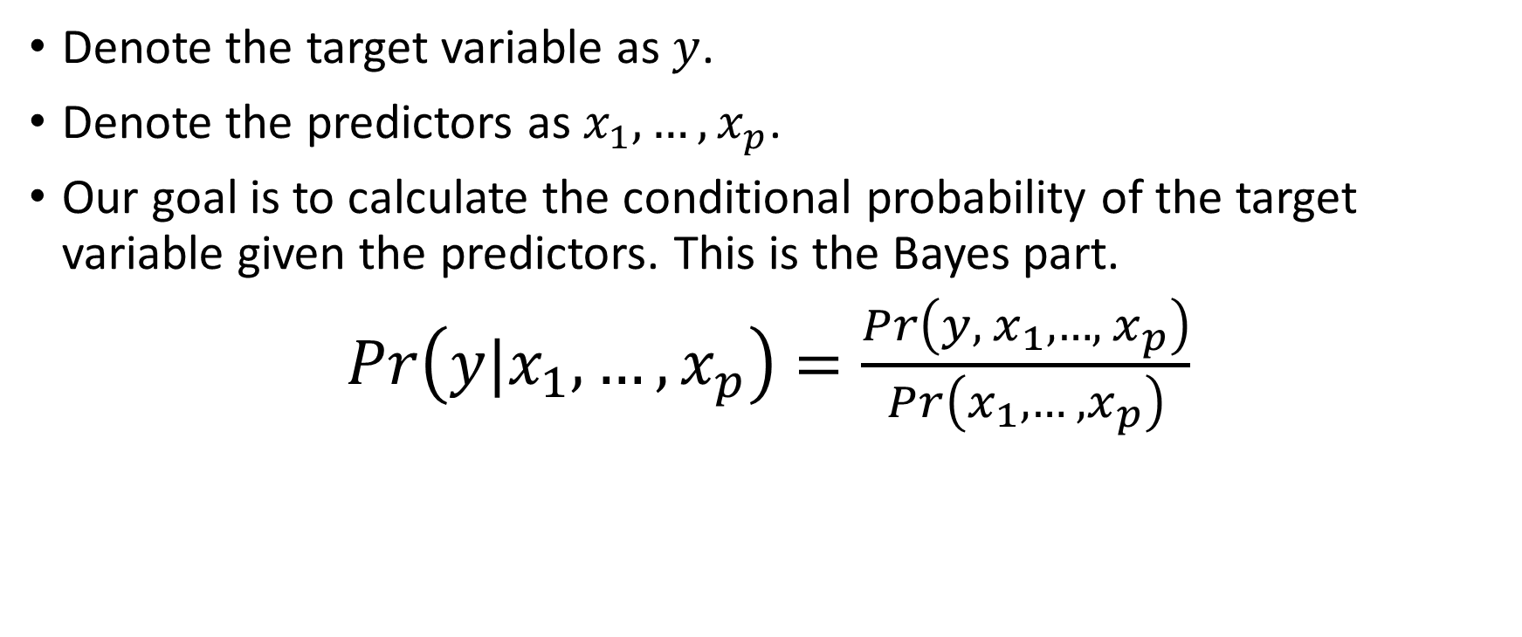
Naïve Bayes: Theory
Denote the target variable as $y$.
Denote the predictors as $x_{1},…,x_{p}$.
Our goal is to calculate the conditional probability of the target variable given the predictors. This is the Bayes part.
$Pr\left(y|x_{1},…,x_{p}\right)=\frac{Pr\left(y,{ x}_{1}, …,{ x}_{p}\right)}{Pr\left(x_{1}, …, x_{p}\right)}$

Slide 21
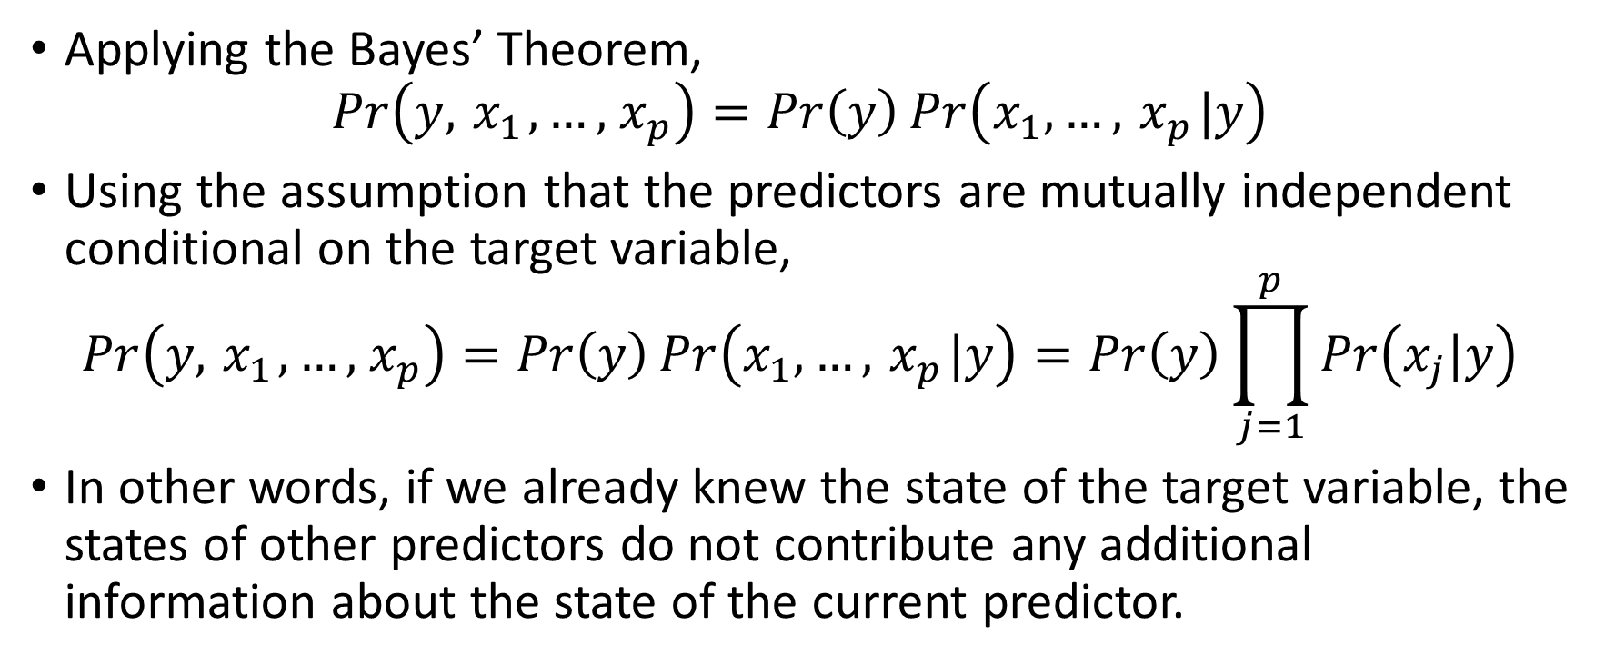
Naïve Bayes: Theory
Applying the Bayes’ Theorem,
$$Pr\left(y,{ x}_{1}, …,{ x}_{p}\right)=Pr\left(y\right)\operatorname{Pr}\left(x_{1}, …,{ x}_{p}|y\right)$$
Using the assumption that the predictors are mutually independent conditional on the target variable,
$$Pr\left(y,{ x}_{1}, …,{ x}_{p}\right)=Pr\left(y\right)\operatorname{Pr}\left(x_{1}, …,{ x}_{p}|y\right)=Pr\left(y\right)\prod_{j=1}^{p}{Pr\left(x_{j}|y\right)}$$
In other words, if we already knew the state of the target variable, the states of other predictors do not contribute any additional information about the state of the current predictor.

Slide 22
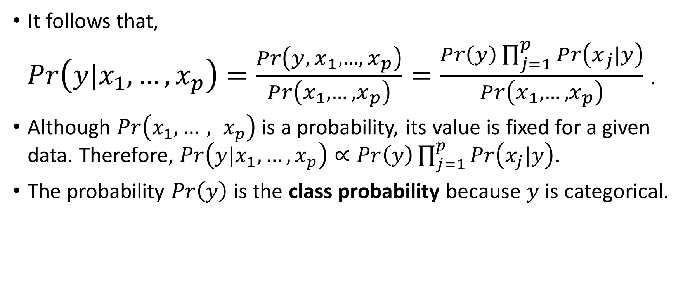
Naïve Bayes: Theory
It follows that,
$Pr\left(y|x_{1},…,x_{p}\right)=\frac{Pr\left(y,{ x}_{1}, …,{ x}_{p}\right)}{Pr\left(x_{1}, …, x_{p}\right)}=\frac{Pr\left(y\right)\prod_{j=1}^{p}{Pr\left(x_{j}|y\right)}}{Pr\left(x_{1}, …, x_{p}\right)}$ .
Although $Pr\left(x_{1}, …, x_{p}\right)$ is a probability, its value is fixed for a given data. Therefore, $Pr\left(y|x_{1},…,x_{p}\right)∝Pr\left(y\right)\prod_{j=1}^{p}{Pr\left(x_{j}|y\right)}$.
The probability $Pr\left(y\right)$ is the class probability because $y$ is categorical.

Slide 23
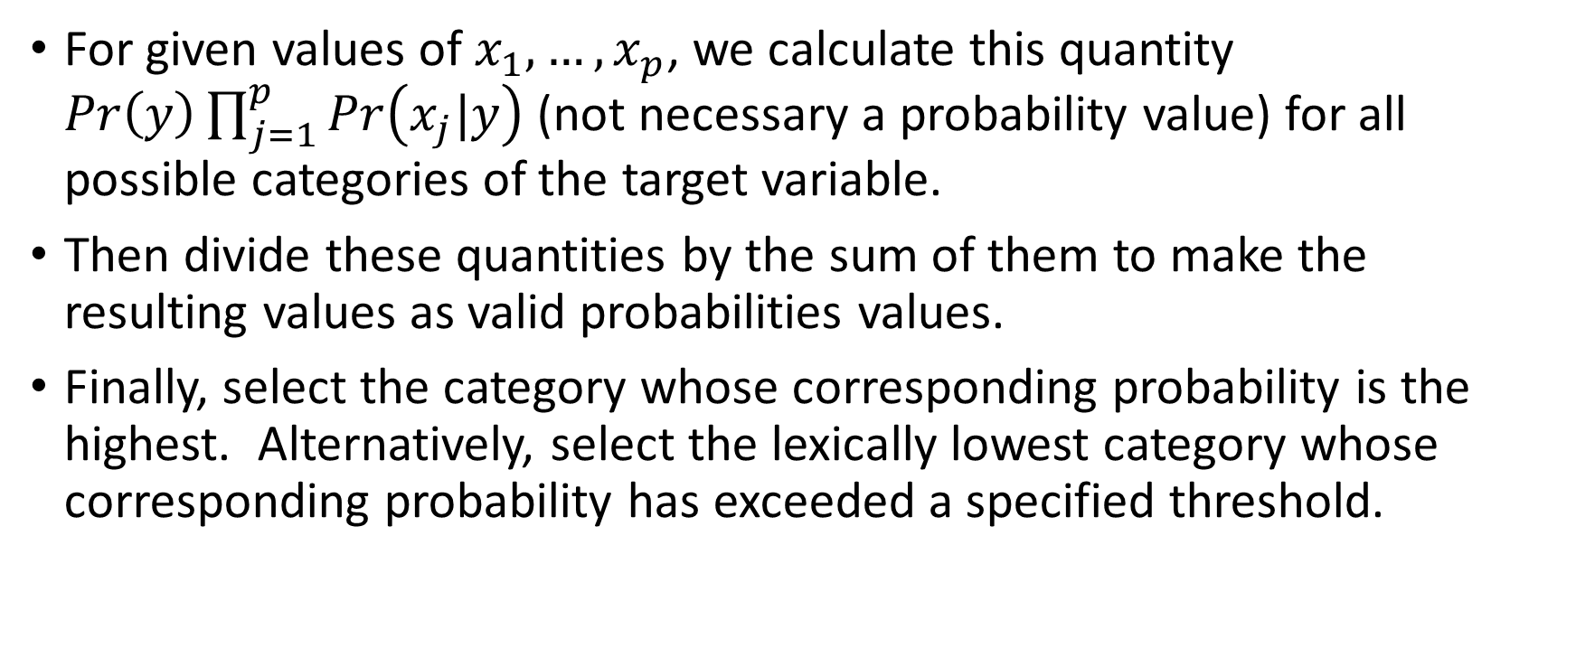
Naïve Bayes: Classifier
For given values of $x_{1},…,x_{p}$, we calculate this quantity $Pr\left(y\right)\prod_{j=1}^{p}{Pr\left(x_{j}|y\right)}$ (not necessary a probability value) for all possible categories of the target variable.
Then divide these quantities by the sum of them to make the resulting values as valid probabilities values.
Finally, select the category whose corresponding probability is the highest. Alternatively, select the lexically lowest category whose corresponding probability has exceeded a specified threshold.

Slide 24

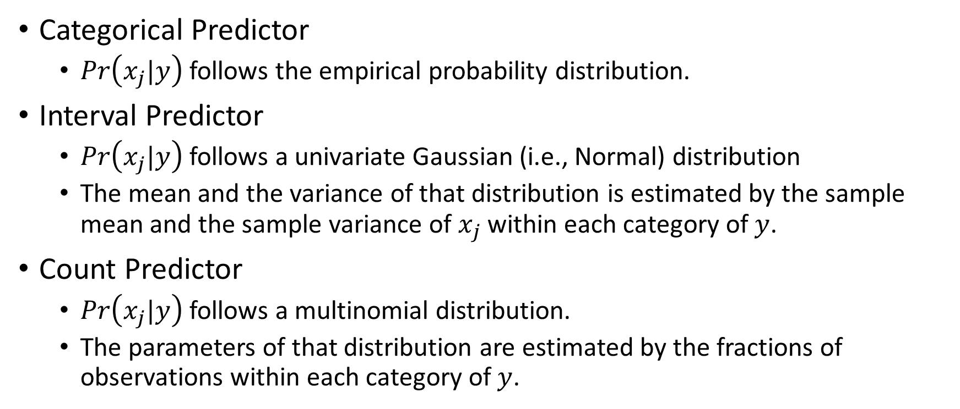
Naïve Bayes: Representing $Pr\left(x_{j}|y\right)$
Categorical Predictor
$Pr\left(x_{j}|y\right)$follows the empirical probability distribution.
Interval Predictor
$Pr\left(x_{j}|y\right)$follows a univariate Gaussian (i.e., Normal) distribution
The mean and the variance of that distribution is estimated by the sample mean and the sample variance of $x_{j}$within each category of $y$.
Count Predictor
$Pr\left(x_{j}|y\right)$follows a multinomial distribution.
The parameters of that distribution are estimated by the fractions of observations within each category of $y$.

Slide 25
Naïve Bayes: Customer Survey
You are working on a marketing campaign to promote the E-Billing service to bank customers. You want to build the profiles of customers who will register for the E-Billing service.
You have access to a recent Customer Survey Data which contains information about 4,952 customers.
The target variable is EBilling (No and Yes)
You consider three categorical predictors
CreditCard: American Express, Discover, MasterCard, Others, and Visa
Gender: Female and Male
JobCategory: Agriculture, Crafts, Labor, Professional, Sales, Service

Slide 26
Naïve Bayes: Customer Survey
EBilling
My Theory:
A person’s aptitude (e.g., genes) to embrace E-Billing may also exemplifies in the person’s gender, the choice of credit card (spending vs. saving), and the career path (work/life balance).
CreditCard
Gender
JobCategory
Week 11 EBilling Naive Bayes.py

Slide 27
Naïve Bayes: Customer Survey
# Define a function to visualize the percent of a particular target category by a nominal predictor
def RowWithColumn (
rowVar, # Row variable
columnVar, # Column predictor
show = 'ROW'): # Show ROW fraction, COLUMN fraction, or BOTH table
countTable = pandas.crosstab(index = rowVar, columns = columnVar, margins = False, dropna = True)
print("Frequency Table: \n", countTable)
print( )
if (show == 'ROW' or show == 'BOTH'):
rowFraction = countTable.div(countTable.sum(1), axis='index')
print("Row Fraction Table: \n", rowFraction)
print( )
if (show == 'COLUMN' or show == 'BOTH'):
columnFraction = countTable.div(countTable.sum(0), axis='columns')
print("Column Fraction Table: \n", columnFraction)
print( )
return
Week 11 EBilling Naive Bayes.py

Slide 28
Naïve Bayes: Customer Survey
EBilling | Count | Class Probability
No | 3,221 | 0.6504
Yes | 1,731 | 0.3496
Count | CreditCard
Ebilling | American Express | Discover | MasterCard | Others | Visa | Total
No | 591 | 788 | 815 | 173 | 854 | 3,221
Yes | 390 | 543 | 369 | 48 | 381 | 1,731
Row Fraction | CreditCard
EBilling | American Express | Discover | MasterCard | Others | Visa | Total
No | 0.1835 | 0.2446 | 0.2530 | 0.0537 | 0.2651 | 1.0000
Yes | 0.2253 | 0.3137 | 0.2132 | 0.0277 | 0.2201 | 1.0000

Slide 29
Naïve Bayes: Customer Survey
Count | Gender
EBilling | Female | Male | Total
No | 1,595 | 1,626 | 3,221
Yes | 895 | 836 | 1,731
Row Fraction | Gender
EBilling | Female | Male | Total
No | 0.4952 | 0.5048 | 1.0000
Yes | 0.5170 | 0.4830 | 1.0000

Slide 30
Naïve Bayes: Customer Survey
Count | JobCategory
EBilling | Agriculture | Crafts | Labor | Professional | Sales | Service | Total
No | 134 | 297 | 474 | 859 | 1,038 | 419 | 3,221
Yes | 78 | 152 | 206 | 512 | 588 | 195 | 1,731
Row Fraction | JobCategory
EBilling | Agriculture | Crafts | Labor | Professional | Sales | Service | Total
No | 0.0416 | 0.0922 | 0.1472 | 0.2667 | 0.3223 | 0.1301 | 1.0000
Yes | 0.0451 | 0.0878 | 0.1190 | 0.2958 | 0.3397 | 0.1127 | 1.0000

Slide 31
Naïve Bayes: Customer Survey
Conditional Probabilities of Ebilling = Yes given CreditCard, Gender, and JobCategory
Pr(EBilling = No|CreditCard = American Express, Gender = Female, JobCategory = Professional)
Pr(EBilling = No) * Pr(CreditCard = American Express|EBilling = No) * Pr(Gender = Female|EBilling = No) * Pr(JobCategory = Professional|EBilling = No)
= 0.6504 * 0.1835 * 0.4952 * 0.2667 = 0.0158

Slide 32
Naïve Bayes: Customer Survey
Conditional Probabilities of Ebilling = No given CreditCard, Gender, and JobCategory
Pr(EBilling = Yes|CreditCard = American Express, Gender = Female, JobCategory = Professional)
Pr(EBilling = Yes) * Pr(CreditCard = American Express|EBilling = Yes) * Pr(Gender = Female|EBilling = Yes) * Pr(JobCategory = Professional|EBilling = Yes)
= 0.3496 * 0.2253 * 0.5170 * 0.2958 = 0.0120

Slide 33
Naïve Bayes: Customer Survey
Recap the results
Pr(EBilling = No|CreditCard = American Express, Gender = Female, JobCategory = Professional) ∝ 0.6504 * 0.1835 * 0.4952 * 0.2667 = 0.0158
Pr(EBilling = Yes|CreditCard = American Express, Gender = Female, JobCategory = Professional) ∝ 0.3496 * 0.2253 * 0.5170 * 0.2958 = 0.0120
The sum is 0.0158 + 0.0120 = 0.0278

Slide 34
Naïve Bayes: Customer Survey
Convert to Valid Probability Values
Pr(EBilling = No|CreditCard = American Express, Gender = Female, JobCategory = Professional) = 0.0158 / 0.0278 = 0.5668
Pr(EBilling = Yes|CreditCard = American Express, Gender = Female, JobCategory = Professional) = 0.0120 / 0.0278 = 0.4332

Slide 35
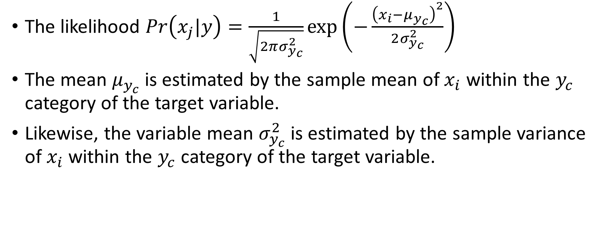
Gaussian Naïve Bayes
The likelihood $Pr\left(x_{j}|y\right)=\frac{1}{\sqrt{2πσ_{y_{c}}^{2}}}exp\left(−\frac{{\left(x_{i}−μ_{y_{c}}\right)}^{2}}{2σ_{y_{c}}^{2}}\right)$
The mean $μ_{y_{c}}$ is estimated by the sample mean of $x_{i}$ within the $y_{c}$ category of the target variable.
Likewise, the variable mean $σ_{y_{c}}^{2}$ is estimated by the sample variance of $x_{i}$ within the $y_{c}$ category of the target variable.

Slide 36
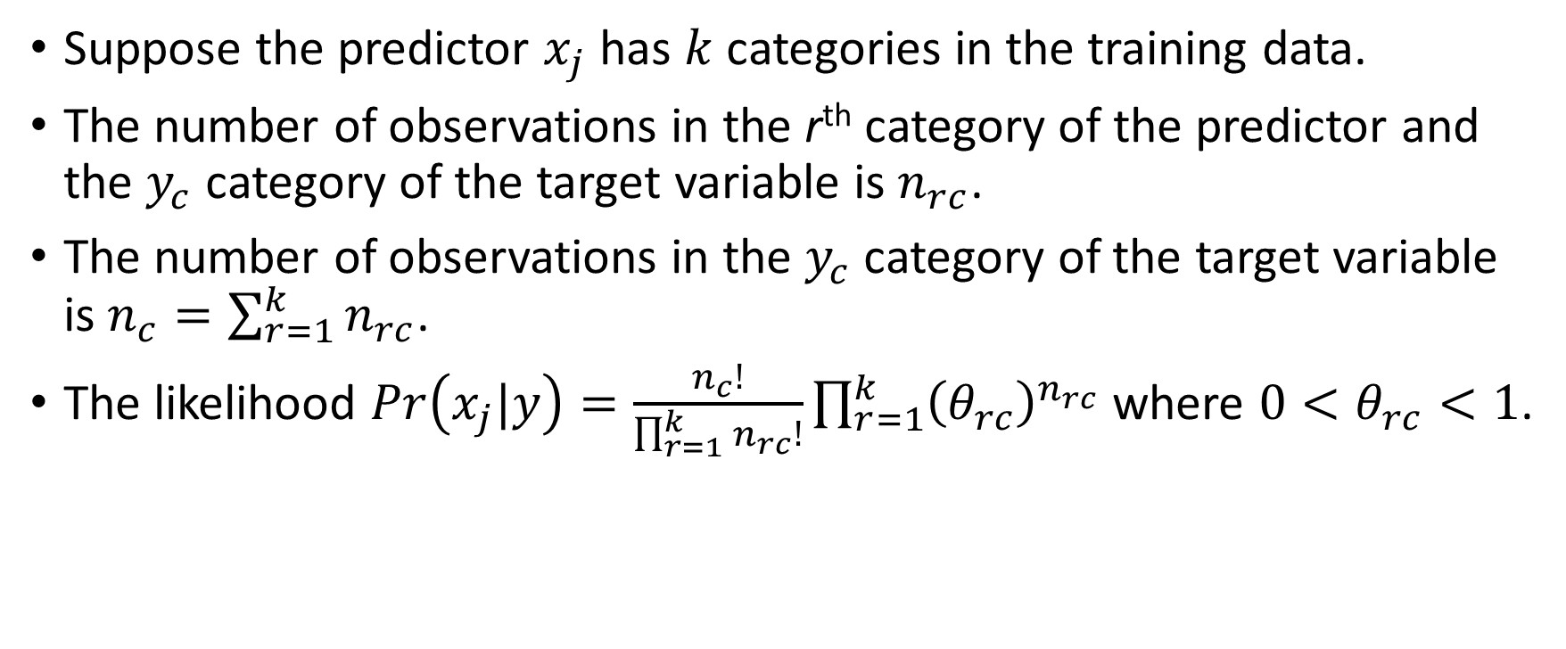
Multinomial Naïve Bayes
Suppose the predictor $x_{j}$ has $k$ categories in the training data.
The number of observations in the r^{th} category of the predictor and the $y_{c}$ category of the target variable is $n_{rc}$.
The number of observations in the $y_{c}$ category of the target variable is $n_{c}=\sum_{r=1}^{k}{n_{rc}}$.
The likelihood $Pr\left(x_{j}|y\right)=\frac{n_{c}!}{\prod_{r=1}^{k}{n_{rc}!}}\prod_{r=1}^{k}{{\left(θ_{rc}\right)}^{n_{rc}}}$ where ${0<θ}_{rc}<1$.

Slide 37
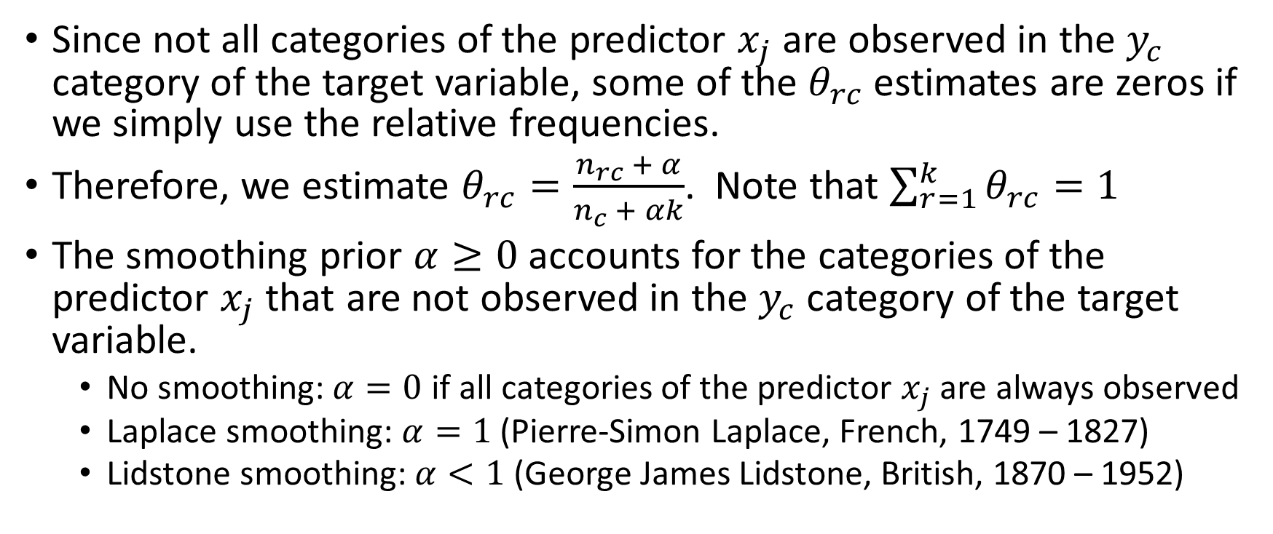
Multinomial Naïve Bayes
Since not all categories of the predictor $x_{j}$ are observed in the $y_{c}$ category of the target variable, some of the $θ_{rc}$ estimates are zeros if we simply use the relative frequencies.
Therefore, we estimate $θ_{rc}=\frac{n_{rc} + α}{n_{c} + αk}$. Note that $\sum_{r=1}^{k}{θ_{rc}}=1$
The smoothing prior $α≥0$ accounts for the categories of the predictor $x_{j}$ that are not observed in the $y_{c}$ category of the target variable.
No smoothing: $α=0$ if all categories of the predictor $x_{j}$ are always observed
Laplace smoothing: $α=1$ (Pierre-Simon Laplace, French, 1749 – 1827)
Lidstone smoothing: $α<1$ (George James Lidstone, British, 1870 – 1952)

Slide 38
Multinomial Naïve Bayes: Text Analysis
Data
Check if the document contains the name of a Chinese city
Reference: https://nlp.stanford.edu/IR-book/html/htmledition/naive-bayes-text-classification-1.html
 | ID | Words in Document | City in China?
Training | 1 | Chinese Beijing Chinese | Yes
 | 2 | Chinese Chinese Shanghai | Yes
 | 3 | Chinese Macao | Yes
 | 4 | Tokyo Japan Chinese | No
Testing | 5 | Chinese Chinese Chinese Tokyo Japan | ?
 | 6 | Beijing Shanghai Macao | ?
Week 11 Chinese City Naive Bayes.py

Slide 39
Multinomial Naïve Bayes: Text Analysis
 | ID | Words in Document | City in China?
Training | 1 | Chinese Beijing Chinese | Yes
 | 2 | Chinese Chinese Shanghai | Yes
 | 3 | Chinese Macao | Yes
 | 4 | Tokyo Japan Chinese | No
Data
Six Features that indicate if a certain word is contained. The features are
Chinese
Beijing
Shanghai
Macao
Tokyo
Japan

Slide 40
Multinomial Naïve Bayes: Text Analysis
import sklearn.naive_bayes as NB
X = numpy.array([[2,1,0,0,0,0],
[2,0,1,0,0,0],
[1,0,0,1,0,0],
[1,0,0,0,1,1]])
y = numpy.array([1,1,1,0])
classifier = NB.MultinomialNB().fit(X, y)
print('Class Count:\n', classifier.class_count_)
print('Log Class Probability:\n', classifier.class_log_prior_ )
print('Feature Count (after adding alpha):\n', classifier.feature_count_)
print('Log Feature Probability:\n', classifier.feature_log_prob_)
predProb = classifier.predict_proba(X)
print('Predicted Conditional Probability (Training):', predProb)
X_test = numpy.array([[3,0,0,0,1,1],
[0,1,1,0,1,1]])
print('Predicted Conditional Probability (Testing):\n', classifier.predict_proba(X_test))

Slide 41
Multinomial Naïve Bayes: Text Analysis
Since three out of four documents have positive identification, the class probabilities are
Pr(y = Positive) = 3/4 = 0.75
Pr(y = Negative) = 1/4 = 0.25.
The natural logarithm of these probabilities are
ln(Pr(y = Positive)) = ln(0.75) = -0.28768207
ln(Pr(y = Negative)) = ln(0.25) = -1.38629436
Class Count:
[1. 3.]
Log Class Probability:
[-1.38629436 -0.28768207]

Slide 42
Multinomial Naïve Bayes: Text Analysis
Count the number of occurrences of each word by identification result.
X = numpy.array([[2,1,0,0,0,0], [2,0,1,0,0,0], [1,0,0,1,0,0], [1,0,0,0,1,1]])
Identification Result | Chinese | Beijing | Shanghai | Macao | Tokyo | Japan
Positive (y = 1) | 5 | 1 | 1 | 1 | 0 | 0
Negative (y = 0) | 1 | 0 | 0 | 0 | 1 | 1

Slide 43
Multinomial Naïve Bayes: Text Analysis
Specify alpha = 1. Thus, add one to each cell of the table
Before
After
Identification Result | Chinese | Beijing | Shanghai | Macao | Tokyo | Japan
Positive (y = 1) | 5 | 1 | 1 | 1 | 0 | 0
Negative (y = 0) | 1 | 0 | 0 | 0 | 1 | 1
Identification Result | Chinese | Beijing | Shanghai | Macao | Tokyo | Japan
Positive (y = 1) | 6 | 2 | 2 | 2 | 1 | 1
Negative (y = 0) | 2 | 1 | 1 | 1 | 2 | 2

Slide 44
Multinomial Naïve Bayes: Text Analysis
Calculate the probability of each word, by Identification Result
Table
Result
Identification Result | Chinese | Beijing | Shanghai | Macao | Tokyo | Japan | Total
Positive (y = 1) | 6 | 2 | 2 | 2 | 1 | 1 | 14
Negative (y = 0) | 2 | 1 | 1 | 1 | 2 | 2 | 9
Identification Result | Chinese | Beijing | Shanghai | Macao | Tokyo | Japan
Positive (y = 1) | 6/14 | 2/14 | 2/14 | 2/14 | 1/14 | 1/14
Negative (y = 0) | 2/9 | 1/9 | 1/9 | 1/9 | 2/9 | 2/9

Slide 45
Multinomial Naïve Bayes: Text Analysis
Natural logarithm of the probabilities, by Identification Result
The probability
The natural logarithm of the probability
Identification Result | Chinese | Beijing | Shanghai | Macao | Tokyo | Japan
Positive (y = 1) | 6/14 | 2/14 | 2/14 | 2/14 | 1/14 | 1/14
Negative (y = 0) | 2/9 | 1/9 | 1/9 | 1/9 | 2/9 | 2/9
Identification Result | Chinese | Beijing | Shanghai | Macao | Tokyo | Japan
Positive (y = 1) | -0.8473 | -1.9459 | -1.9459 | -1.9459 | -2.6391 | -2.6391
Negative (y = 0) | -1.5041 | -2.1972 | -2.1972 | -2.1972 | -1.5041 | -1.5041

Slide 46
Multinomial Naïve Bayes: Text Analysis
The natural logarithm of the probability
Identification Result | Chinese | Beijing | Shanghai | Macao | Tokyo | Japan
Positive (y = 1) | -0.8473 | -1.9459 | -1.9459 | -1.9459 | -2.6391 | -2.6391
Negative (y = 0) | -1.5041 | -2.1972 | -2.1972 | -2.1972 | -1.5041 | -1.5041
Log Feature Probability:
[[-1.5040774 -2.19722458 -2.19722458 -2.19722458 -1.5040774 -1.5040774 ]
[-0.84729786 -1.94591015 -1.94591015 -1.94591015 -2.63905733 -2.63905733]]

Slide 47
Multinomial Naïve Bayes: Text Analysis
Given the numbers of occurrences of the words, what is the likelihood of a positive identification?
Let us pick the first document.
Pr(Y = Positive | Chinese = 2, Beijing = 1, Shanghai = 0, Macao = 0, Tokyo = 0, Japan = 0) ∝ Pr(Y = Positive) * Pr(Chinese = 2, Beijing = 1, Shanghai = 0, Macao = 0, Tokyo = 0, Japan = 0 | Y = Positive) ∝ (3/4) * (6/14)^2 * (2/14)^1 * (2/14)^0 * (2/14)^0 * (1/14)^0 * (1/14)^ 0 = 0.0196793

Slide 48
Multinomial Naïve Bayes: Text Analysis
Pr(Y = Negative | Chinese = 2, Beijing = 1, Shanghai = 0, Macao = 0, Tokyo = 0, Japan = 0) ∝ Pr(Y = Negative) * Pr(Chinese = 2, Beijing = 1, Shanghai = 0, Macao = 0, Tokyo = 0, Japan = 0 | Y = Negative) ∝ (1/4) * (2/9)^2 * (1/9)^1 * (1/9)^0 * (1/9)^0 * (2/9)^0 * (2/9)^ 0 = 0.001371742

Slide 49
Multinomial Naïve Bayes: Text Analysis
For the first document,
Pr(Y = Positive | Chinese = 2, Beijing = 1, Shanghai = 0, Macao = 0, Tokyo = 0, Japan = 0) ∝ 0.0196793
Pr(Y = Negative | Chinese = 2, Beijing = 1, Shanghai = 0, Macao = 0, Tokyo = 0, Japan = 0) ∝ 0.001371742
Final step is to rescale these two values such that the resulting values add up to one.
Pr(Y = Positive | Chinese = 2, Beijing = 1, Shanghai = 0, Macao = 0, Tokyo = 0, Japan = 0) = 0.0196793 / (0.0196793 + 0.001371742) = 0.9348
Pr(Y = Negative | Chinese = 2, Beijing = 1, Shanghai = 0, Macao = 0, Tokyo = 0, Japan = 0) = 0.001371742 / (0.0196793 + 0.001371742) = 0.0652

Slide 50
Multinomial Naïve Bayes: Text Analysis
Predicted Probabilities for all the documents
 | ID | Words in Document | City in China? | Pr(Positive|Dcoument) | Pr(Negative|Document)
Training | 1 | Chinese Beijing Chinese | Yes | 0.93483733 | 0.06516267
 | 2 | Chinese Chinese Shanghai | Yes | 0.93483733 | 0.06516267
 | 3 | Chinese Macao | Yes | 0.88149940 | 0.11850060
 | 4 | Tokyo Japan Chinese | No | 0.37412328 | 0.62587672
Testing | 5 | Chinese Chinese Chinese Tokyo Japan | ? | 0.68975861 | 0.31024139
 | 6 | Beijing Shanghai Macao | ? | 0.33878380 | 0.66121620
Predicted Conditional Probability (Training): [[0.06516267 0.93483733]
[0.06516267 0.93483733]
[0.1185006 0.8814994 ]
[0.62587672 0.37412328]]
Predicted Conditional Probability (Testing):
[[0.31024139 0.68975861]
[0.6612162 0.3387838 ]]

Slide 51
Mid-Term Test
This is an open-book take-home test.
Your test score will count 25% towards your final grade.
The questions are already available on Blackboard from 12:00 pm on Wednesday, March 27, 2019.
The firm deadline to submit your answers is 12:30 pm on Wednesday, April 3, 2019.
No requests for extending the deadline will be considered.

Slide 52
Mid-Term Test
INSTRUCTIONS
Students are not required to attach their Python codes with their answers.
Students have up to 3 attempts to submit your answers. However, only the last attempt will be graded.
Students WILL receive feedback (Correct or Try Again) after submitting your answers to Questions 1 to 10.
For Questions 1 to 10, please put your answers in the designated areas.
For Question 11, please put your answers in a PDF file and then attach it to the question. Same for Question 12.
Click on the links to the CSV data files for Questions 11 and 12.

